Slide 1



Sales Dashboard
View in Power BI
Last data refresh:
9/11/2023 6:47:18 PM UTC
Downloaded at:
9/11/2023 6:48:38 PM UTC

Slide 2
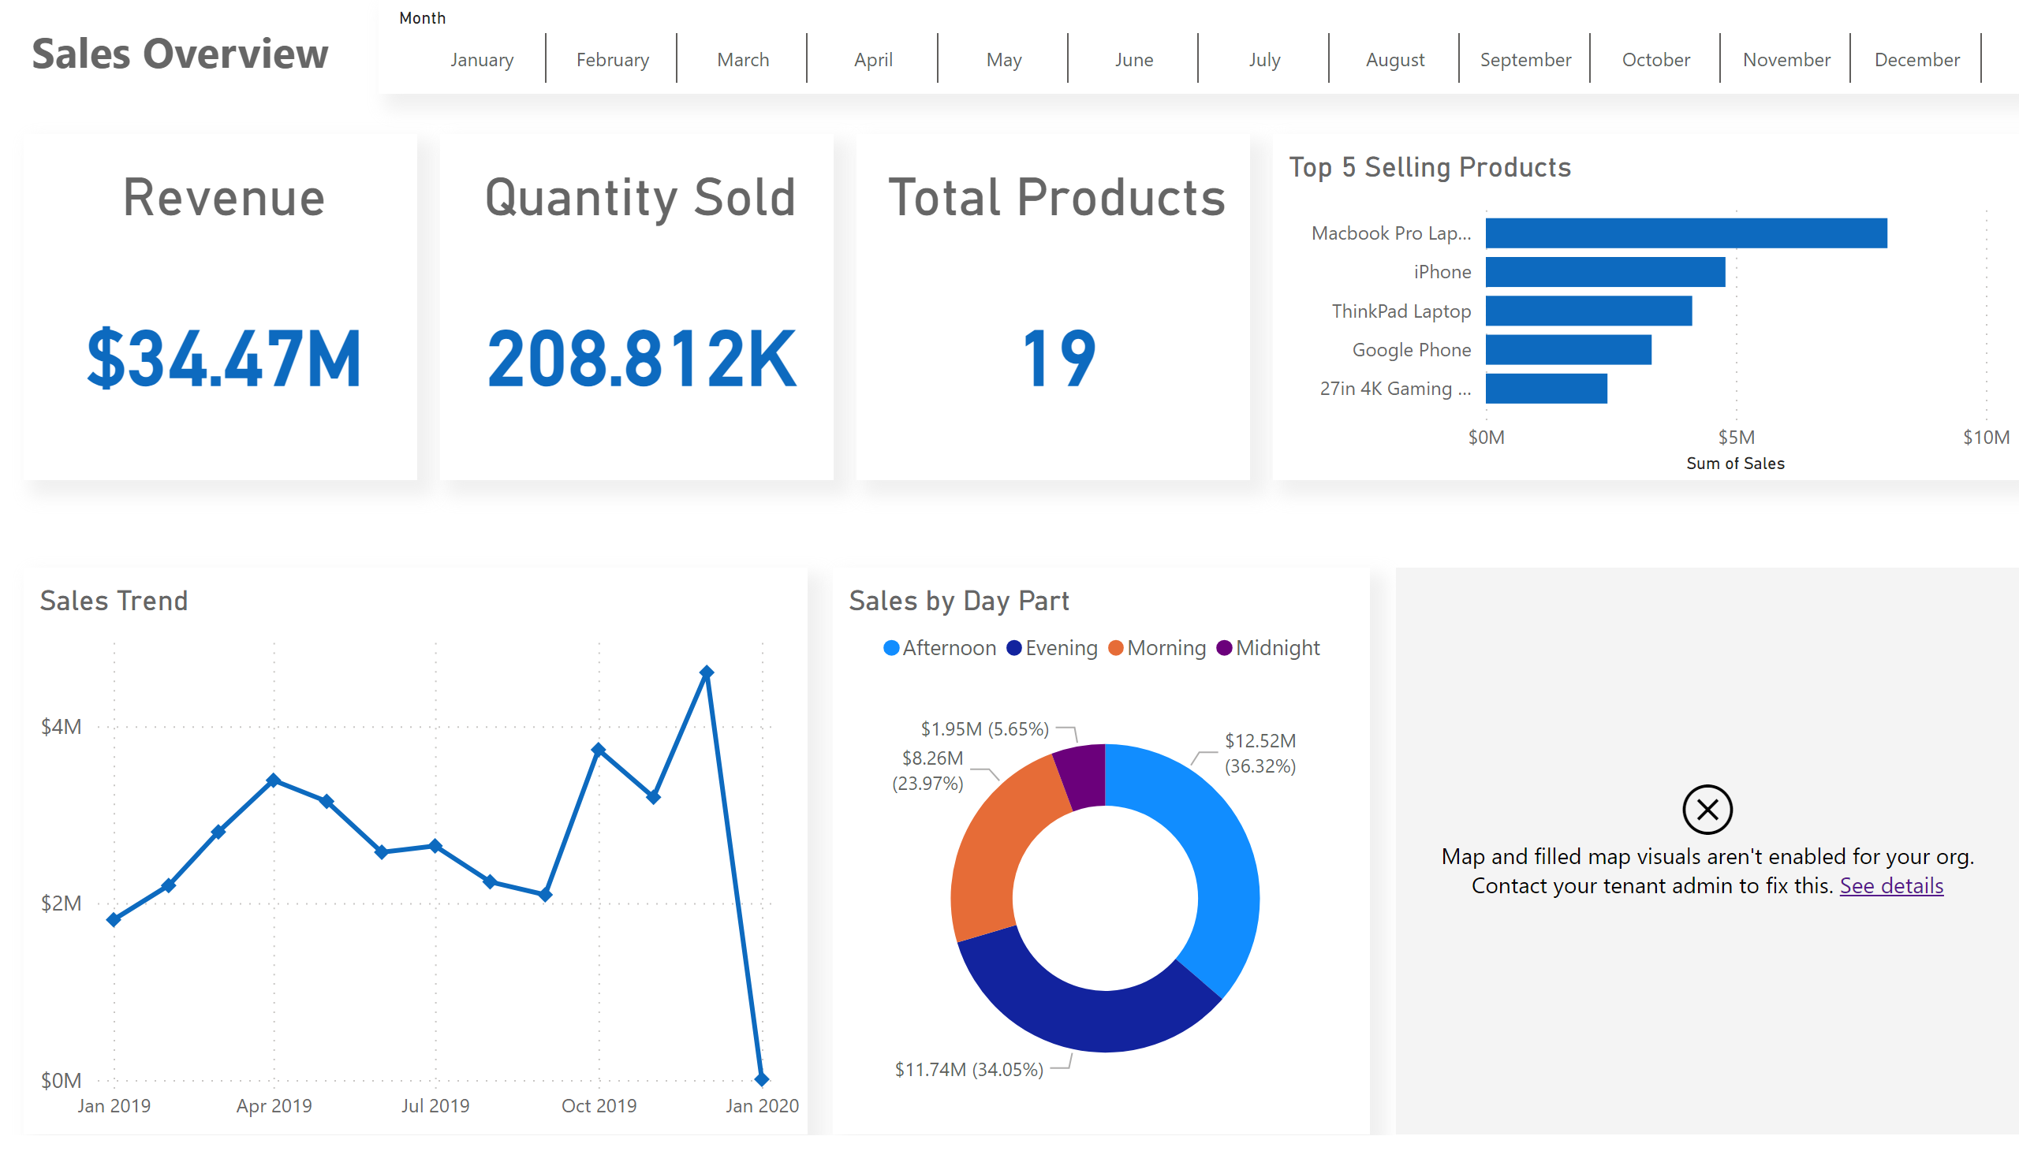
Sales Overview
Notes:
textbox
No alt text provided
slicer
No alt text provided
Revenue
No alt text provided
Quantity Sold
No alt text provided
Total Products
No alt text provided
Top 5 Selling Products
No alt text provided
Sales Trend
No alt text provided
Sales by Day Part
No alt text provided
map
No alt text provided

